Slide 1

Training & Development Templates
A Modular Approach for Professionals
[Presenter First Last]
Training & Development Specialist

Slide 2


Training & Development
Modular Template Overview
Modular templates offer versatile solutions designed for professional training and development environments. They adapt easily to various learning topics, ensuring clarity and engagement for diverse audiences.

Slide 3

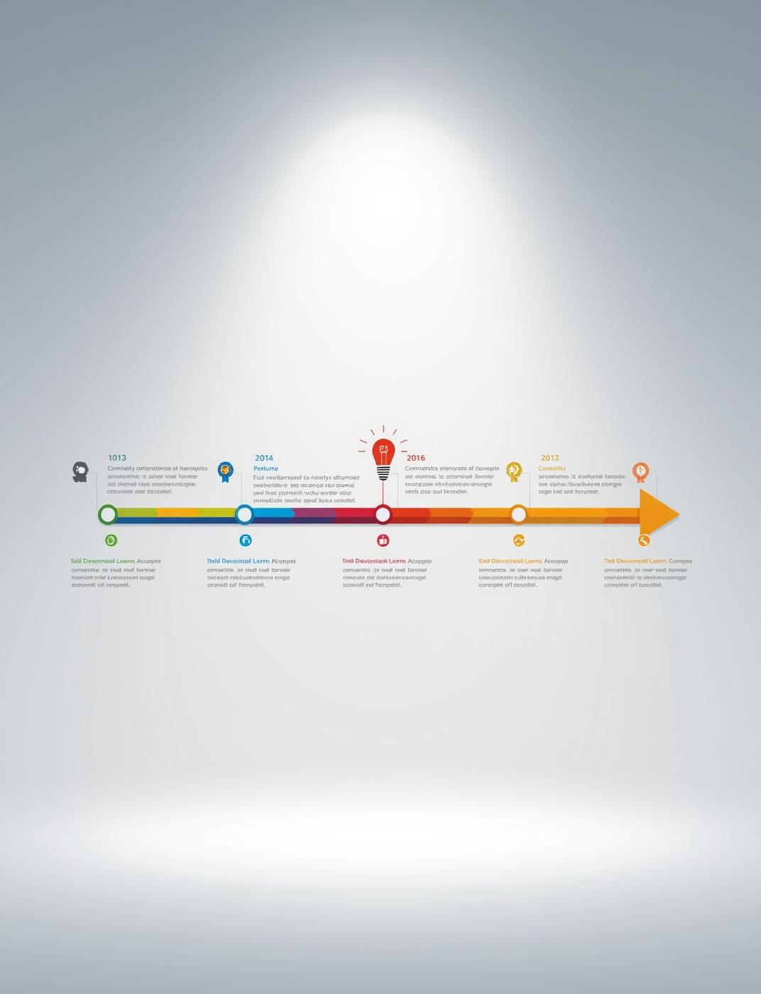
Skill Development Roadmap
Visualizing your learning paths effectively
This template presents a clear roadmap for skill acquisition, emphasizing milestones and progress indicators to visualize your training journey and enhance participant engagement.

Slide 4
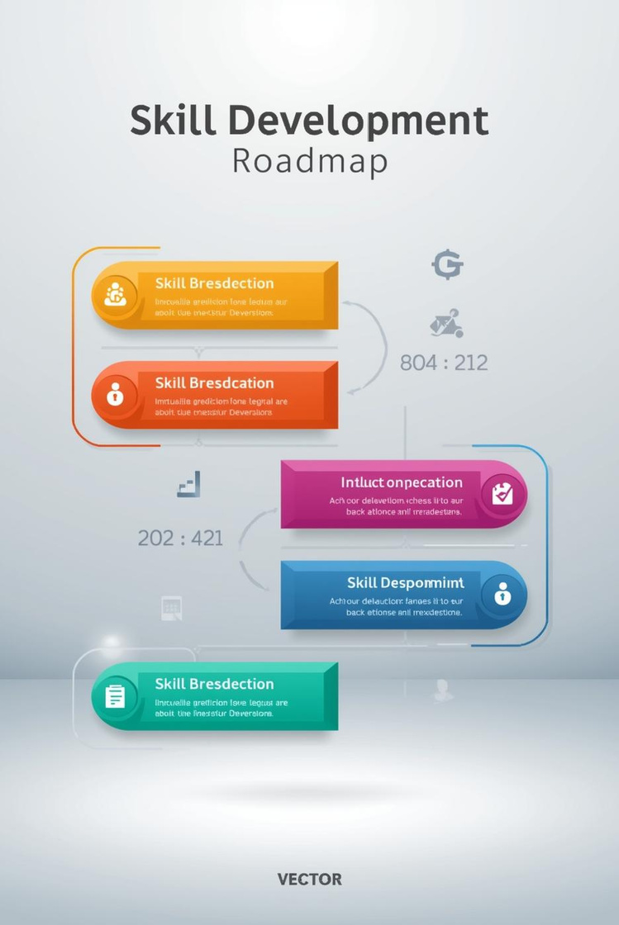
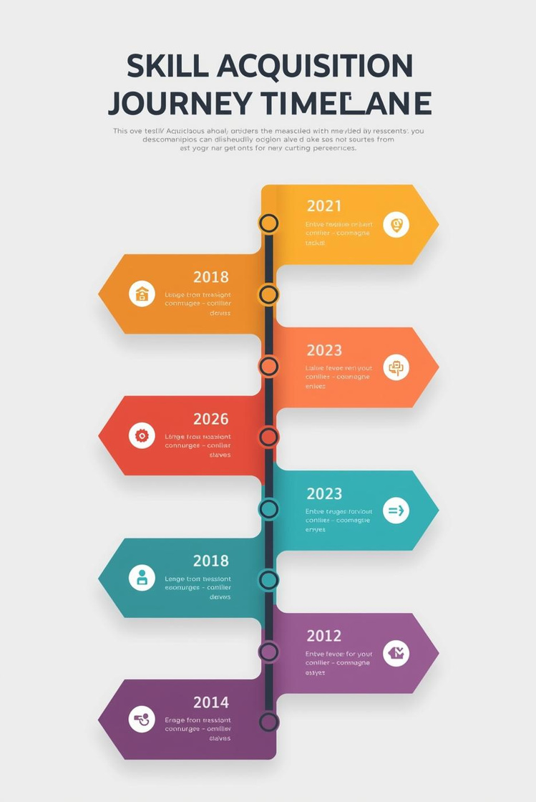

Key Components and Layout Examples
Milestones
Layout Examples
Visual indicators of progress throughout the training journey
Suggested designs for flexible training session presentations

Slide 5

Key Statistics in Skill Development
Insights on Learning and Training Progress
85%
70%
Successful Skill Acquisition Rate
Improved Engagement in Training Programs
Percentage of learners mastering new skills
Rise in participant satisfaction and retention rates

Slide 6

Training Metrics Dashboard
Visualizing Performance and Impact Data
The Training Metrics Dashboard enables organizations to effectively visualize key performance indicators, fostering data-driven decisions for monitoring training effectiveness and enhancing learner engagement.

Slide 7
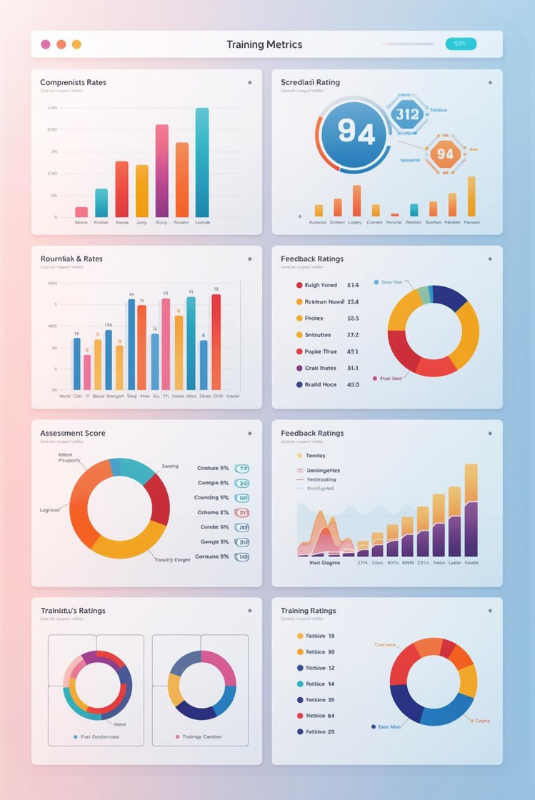
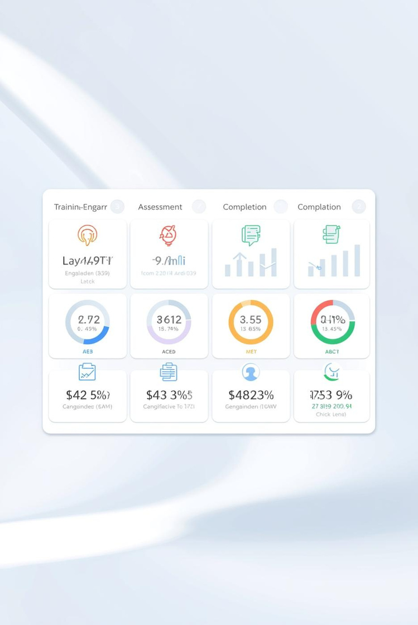

Training Metrics Dashboard Concepts
Performance Indicators
Engagement Tracking
Visualize training success through key metrics tracked
Monitor learner interaction and feedback effectively

Slide 8

Key Statistics for Training Metrics
Insights into performance and engagement data
85%
92%
Training Completion Rate
Learner Satisfaction Score
Percentage of participants completing training sessions
Average rating from post-training feedback surveys

Slide 9
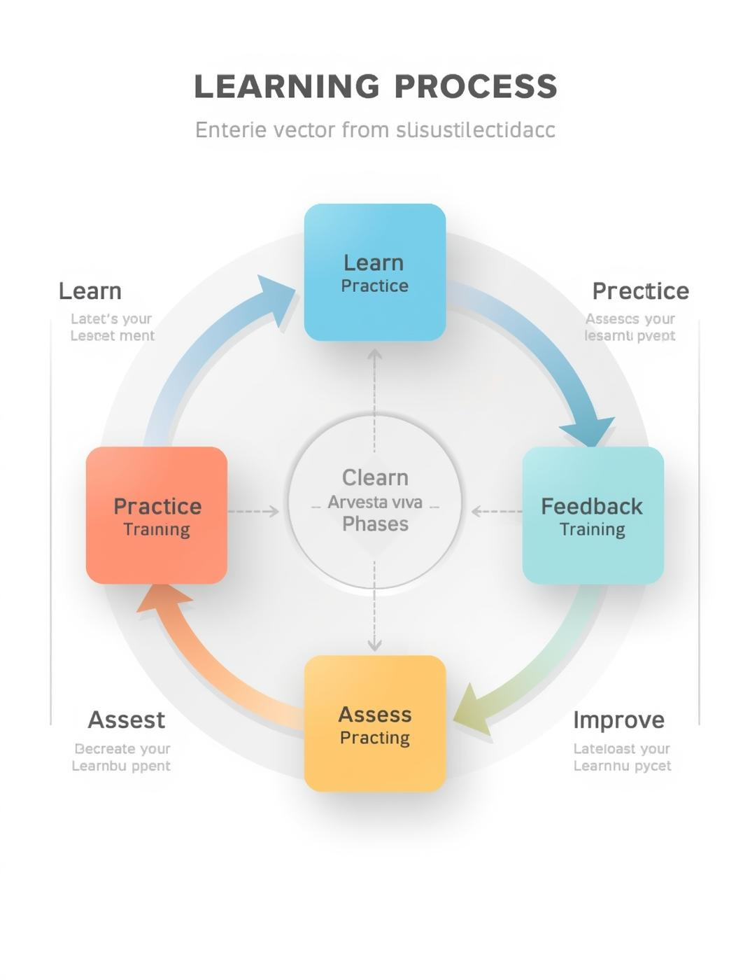
Interactive Learning Cycle
Emphasizing Iterative Training and Feedback Process
The Interactive Learning Cycle template visually represents the iterative training process, encouraging continuous improvement through feedback. Each phase fosters engagement, making training more effective and adaptive.

Slide 10
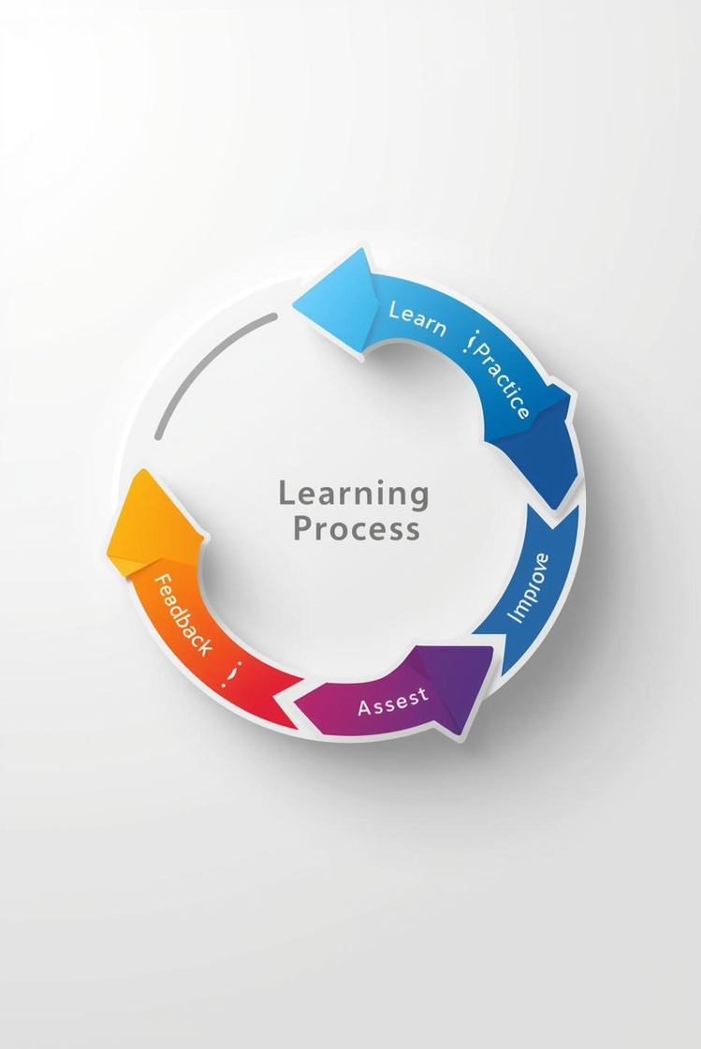
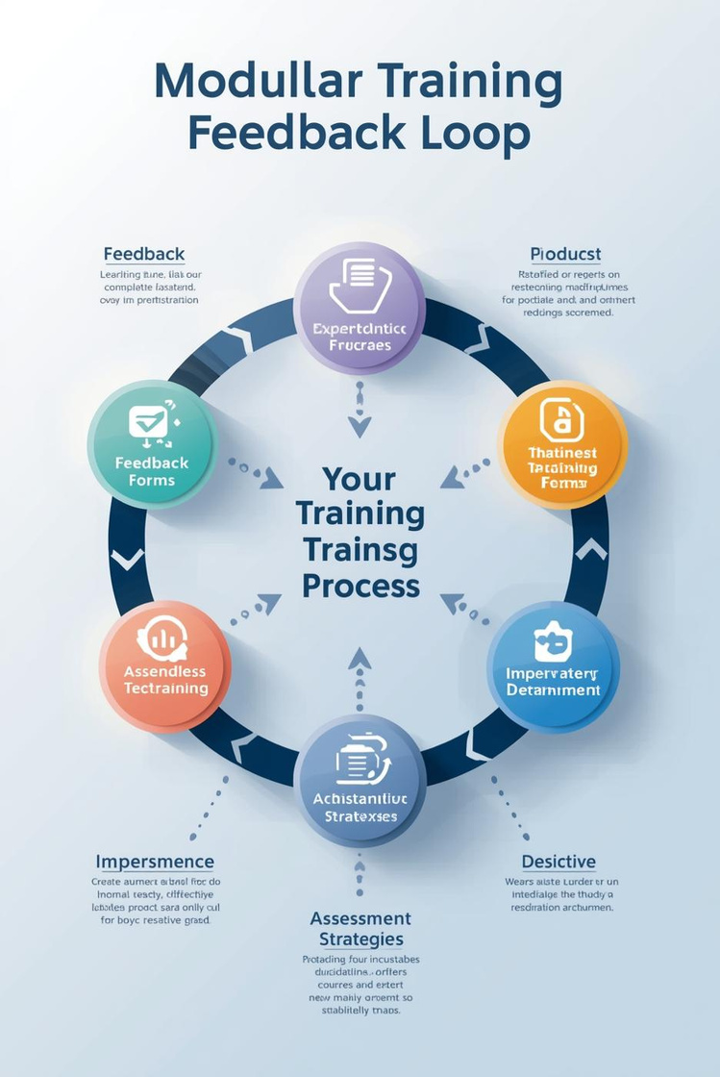
Interactive Learning Cycle: Phases and Directional Arrows
Learning Process
Continuous Improvement
Structured phases ensure effective skill development.
Ongoing feedback drives training effectiveness.

Slide 11
Key Statistics in Training
Insights into the Learning Cycle
75%
90%
Increased retention rates
Higher engagement levels
Participants retain more knowledge through cycles.
Engaged learners perform better in assessments.

Slide 12
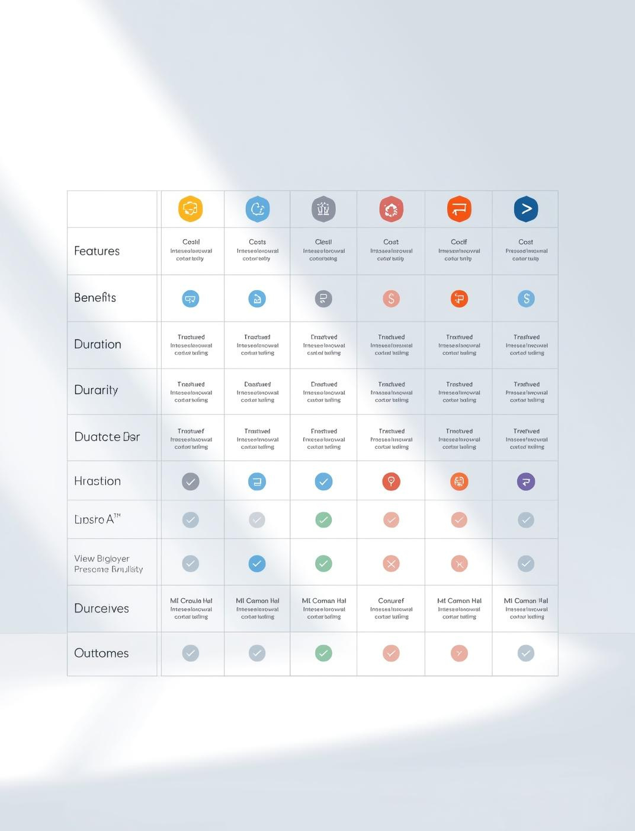
Training Module Comparison
Analyzing Different Training Options Effectively
This template facilitates clear comparisons between various training methods, enabling organizations to evaluate features, benefits, and costs, ultimately guiding informed decisions on training selection.

Slide 13
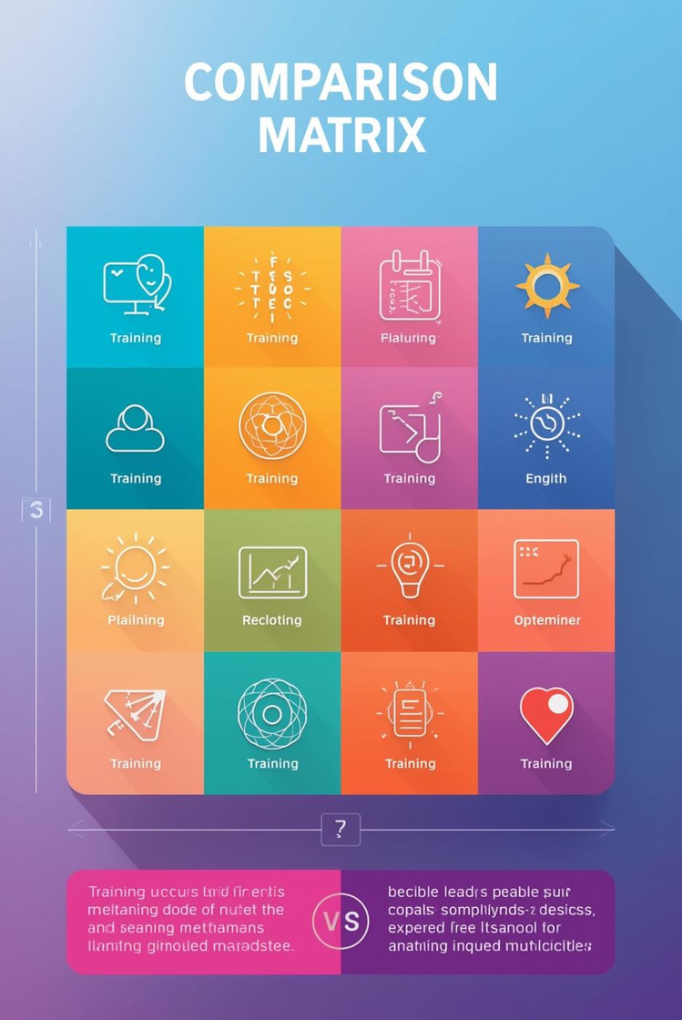

Comparing Training Methods Effectively
Comparison Chart
Matrix Layout
Visualizing differences in training methods and outcomes
Organizing features of various training options clearly

Slide 14
Key Statistics for Training Comparison
Insights into effective training decisions
75%
90%
Increase in learner engagement
Cost savings from e-learning
Reflects effectiveness of interactive training modules
Demonstrates financial benefits versus traditional methods

Slide 15
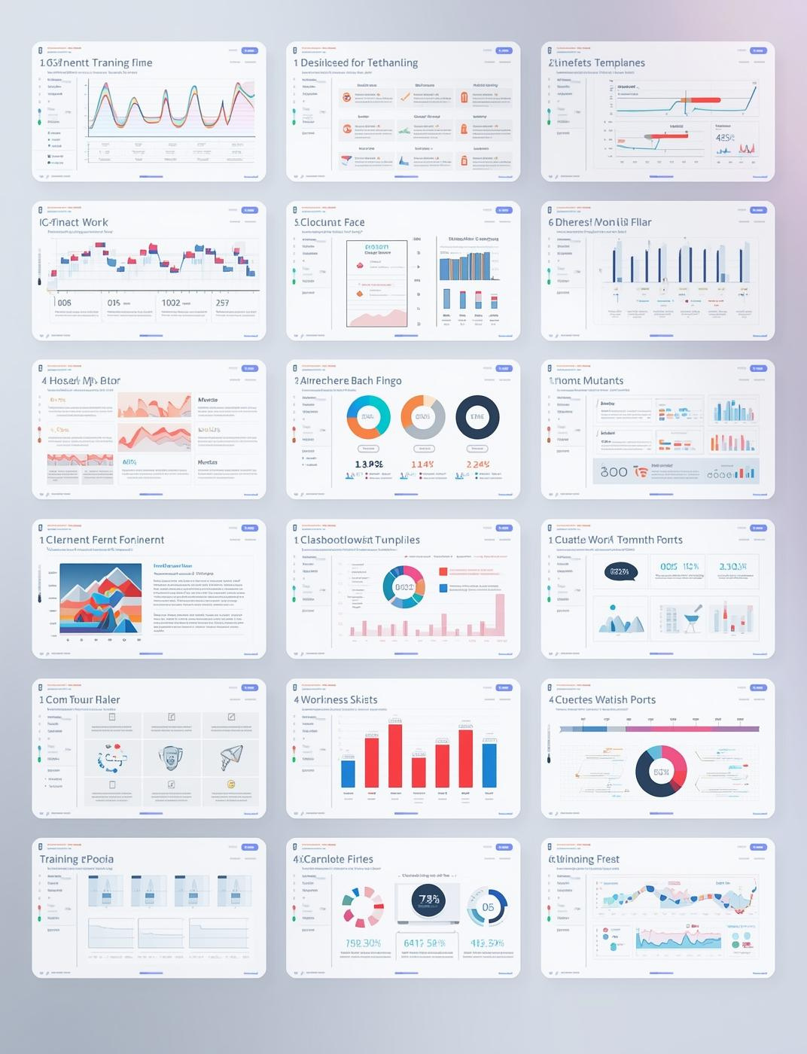

Conclusion and Tips

Slide 16


Contact Us
Get in touch for more information
Email
hello@reallygreatsite.com
Social Media
@reallygreatsite
Phone
123-456-7890

